Slide 1
USACO
2018 US Open Contest, Gold
Mu Niu

Slide 2

Problem 3 Talent Show
Problem Recap
$1≤N≤250$
$1≤W≤1000$
$1≤w_{i}≤{10}^{6}, i∈\left[1,N\right]$
$1≤t_{i}≤{10}^{3}, i∈\left[1,N\right]$
Goal:
$$max\left(\frac{\sum_{i∈S}{t_{i}}}{\sum_{i∈S}{w_{i}}}\right), \sum_{i∈S}{w_{i}}≥W, S⊆\left\{1,2,…,N\right\}$$

Slide 3

Problem 3 Talent Show
Brute Force:
Enumerate all possible combinations: $S⊆\left\{1,2,…,N\right\}$
Time complexity: $O\left(2^{N}\right)$
$2^{250}≈{10}^{75}$, way larger than ${10}^{8}$
Estimation trick: $2^{10}=1024≈{10}^{3}$

Slide 4
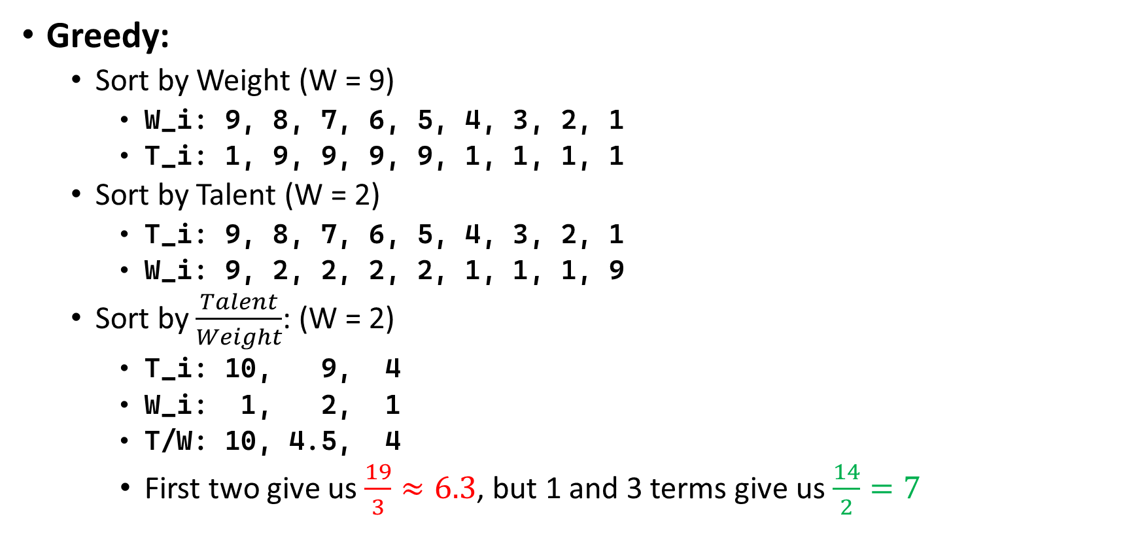
Problem 3 Talent Show
Greedy:
Sort by Weight (W = 9)
W_i: 9, 8, 7, 6, 5, 4, 3, 2, 1
T_i: 1, 9, 9, 9, 9, 1, 1, 1, 1
Sort by Talent (W = 2)
T_i: 9, 8, 7, 6, 5, 4, 3, 2, 1
W_i: 9, 2, 2, 2, 2, 1, 1, 1, 9
Sort by $\frac{Talent}{Weight}$: (W = 2)
T_i: 10, 9, 4
W_i: 1, 2, 1
T/W: 10, 4.5, 4
First two give us $\frac{19}{3}≈6.3$, but 1 and 3 terms give us $\frac{14}{2}=7$

Slide 5
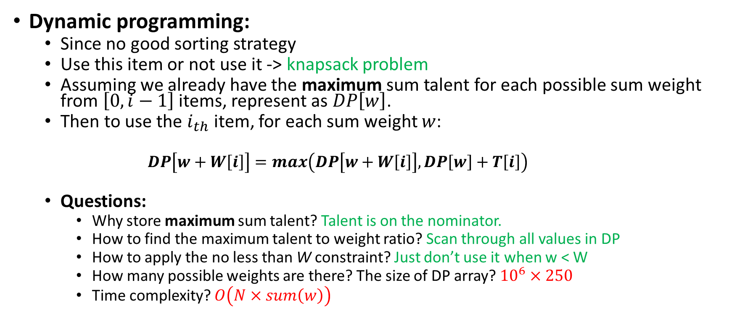
Problem 3 Talent Show
Dynamic programming:
Since no good sorting strategy
Use this item or not use it -> knapsack problem
Assuming we already have the maximum sum talent for each possible sum weight from $\left[0,i−1\right]$ items, represent as $DP\left[w\right]$.
Then to use the $i_{th}$ item, for each sum weight $w$:
$$DP\left[w+W\left[i\right]\right]=max\left(DP\left[w+W\left[i\right]\right],DP\left[w\right]+T\left[i\right]\right)$$
Questions:
Why store maximum sum talent? Talent is on the nominator.
How to find the maximum talent to weight ratio? Scan through all values in DP
How to apply the no less than W constraint? Just don’t use it when w < W
How many possible weights are there? The size of DP array? ${10}^{6}×250$
Time complexity? $O\left(N×sum\left(w\right)\right)$

Slide 6
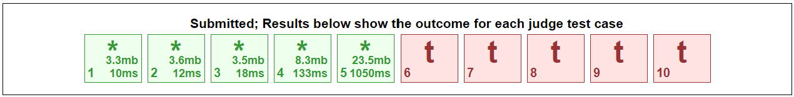
Problem 3 Talent Show
Core Code (TLE):
unordered_map<int, int> dp; // max sum talent
dp[0] = 0;
for (int i = 0; i < N; ++i) {
const auto temp = dp;
for (const auto& [w, t] : temp) {
dp[w + weights[i]] = max(dp[w + weights[i]], t + talents[i]);
}
}

Slide 7
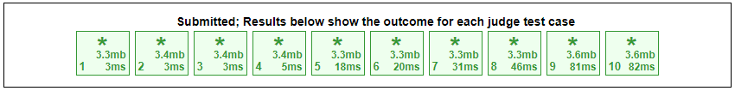
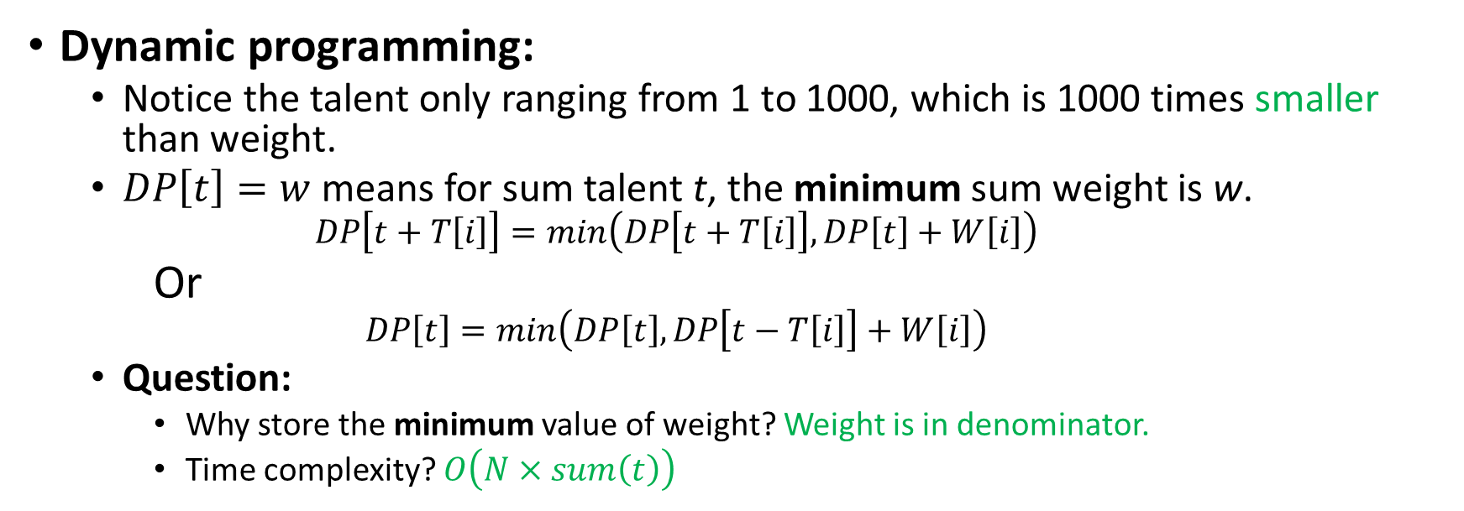
Problem 3 Talent Show
Dynamic programming:
Notice the talent only ranging from 1 to 1000, which is 1000 times smaller than weight.
$DP\left[t\right]=w$ means for sum talent t, the minimum sum weight is w.
$$DP\left[t+T\left[i\right]\right]=min\left(DP\left[t+T\left[i\right]\right],DP\left[t\right]+W\left[i\right]\right)$$
Or
$$DP\left[t\right]=min\left(DP\left[t\right],DP\left[t−T\left[i\right]\right]+W\left[i\right]\right)$$
Question:
Why store the minimum value of weight? Weight is in denominator.
Time complexity? $O\left(N×sum\left(t\right)\right)$
vector<int> dp(sum_talent + 1, 250 * 1000000);
dp[0] = 0;
for (const auto& [weight, talent] : cows) {
for (int t = sum_talent; t >= talent; --t) {
dp[t] = min(dp[t], dp[t - talent] + weight);
}
}

Slide 8
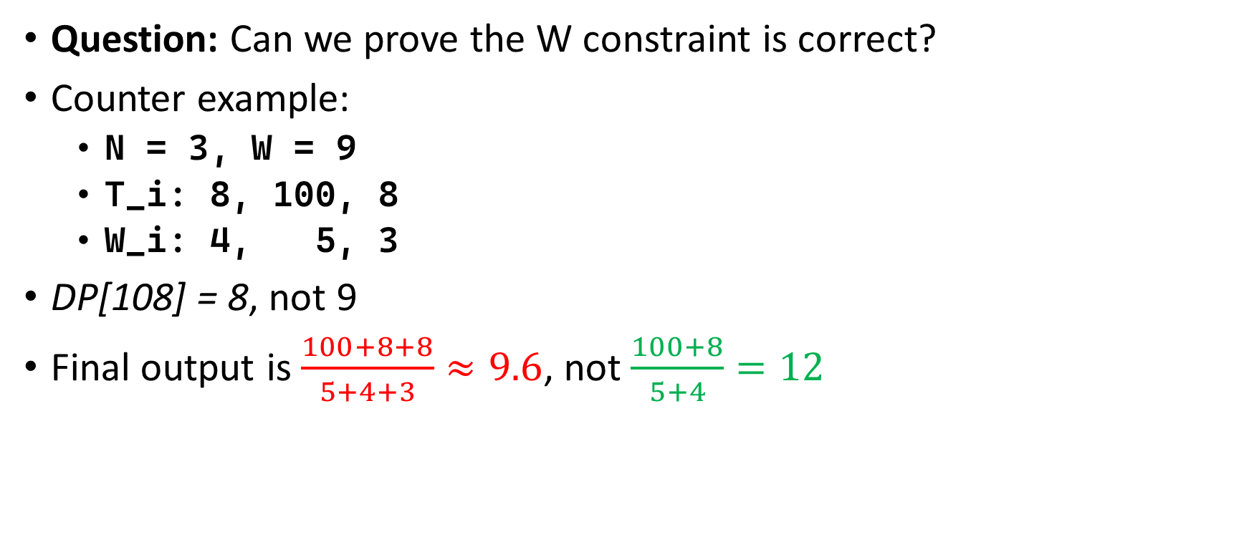
Problem 3 Talent Show
Question: Can we prove the W constraint is correct?
Counter example:
N = 3, W = 9
T_i: 8, 100, 8
W_i: 4, 5, 3
DP[108] = 8, not 9
Final output is $\frac{100+8+8}{5+4+3}≈9.6$, not $\frac{100+8}{5+4}=12$

Slide 9
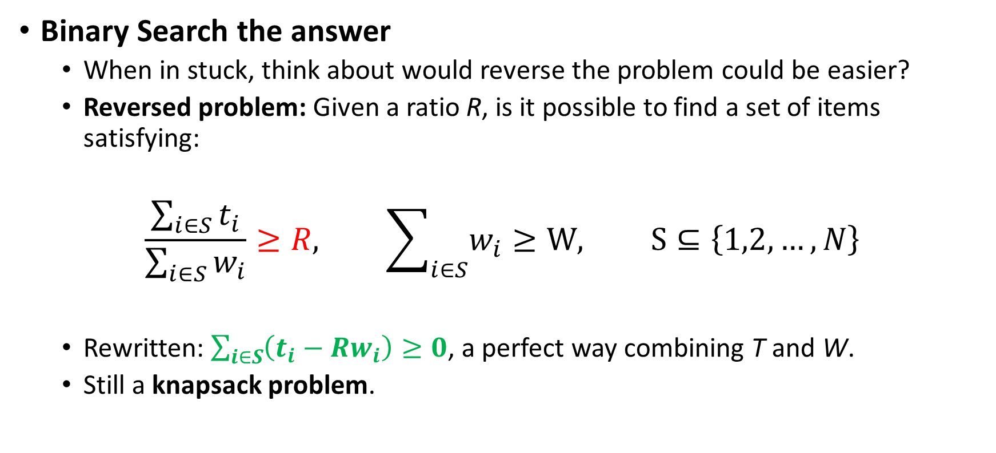
Problem 3 Talent Show
Binary Search the answer
When in stuck, think about would reverse the problem could be easier?
Reversed problem: Given a ratio R, is it possible to find a set of items satisfying:
$$\frac{\sum_{i∈S}{t_{i}}}{\sum_{i∈S}{w_{i}}}≥R, \sum_{i∈S}{w_{i}}≥W, S⊆\left\{1,2,…,N\right\}$$
Rewritten: $\sum_{i∈S}{\left(t_{i}−Rw_{i}\right)}≥0$, a perfect way combining T and W.
Still a knapsack problem.

Slide 10
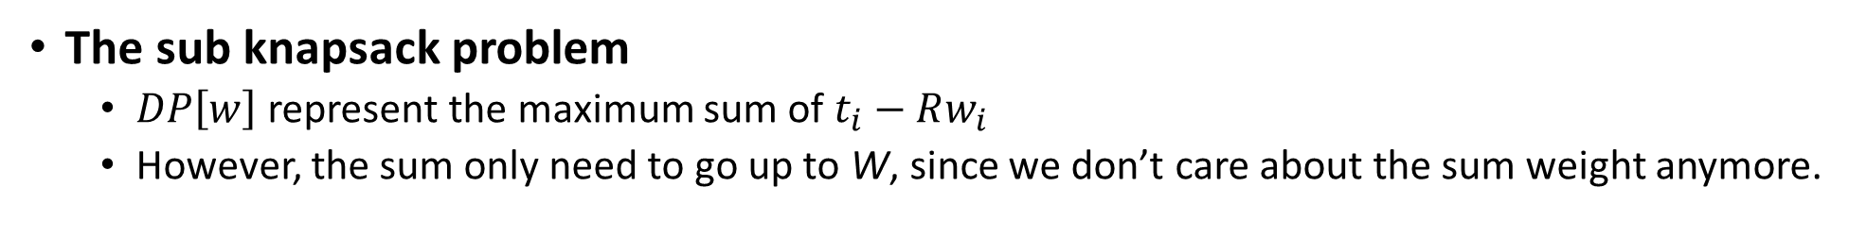
Problem 3 Talent Show
The sub knapsack problem
$DP\left[w\right]$ represent the maximum sum of $t_{i}−Rw_{i}$
However, the sum only need to go up to W, since we don’t care about the sum weight anymore.
bool knapsack(const vector<pair<int, int>>& cows, const int W, const int64_t ratio) {
vector<int64_t> dp(W + 1, INT_MIN);
dp[0] = 0;
for (const auto& [weight, talent] : cows) {
int64_t combined = 1000 * talent - ratio * weight;
for (int w = W; w >= 0; --w) {
if (dp[w] != INT_MIN) {
dp[min(W, w + weight)] = max(dp[min(W, w + weight)], dp[w] + combined);
}
}
}
return dp[W] >= 0;
}

Slide 11
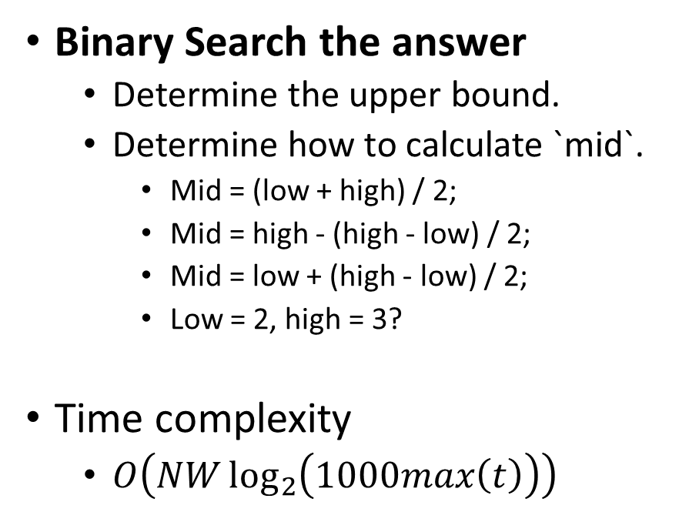
Problem 3 Talent Show
int main() {
ifstream fin("talent.in");
ofstream fout("talent.out");
int N, W;
fin >> N >> W;
// <weight, talent>
vector<pair<int, int>> cows(N);
for (int i = 0; i < N; ++i) {
fin >> cows[i].first >> cows[i].second;
}
int low = 0, high = 1000 * 1000;
while (low < high) {
int mid = high - (high - low) / 2;
if (knapsack(cows, W, mid)) {
low = mid;
} else {
high = mid - 1;
}
}
fout << low;
}
Binary Search the answer
Determine the upper bound.
Determine how to calculate `mid`.
Mid = (low + high) / 2;
Mid = high - (high - low) / 2;
Mid = low + (high - low) / 2;
Low = 2, high = 3?
Time complexity
$O\left(NW\log_{2}\left(1000max\left(t\right)\right)\right)$

